Slide 1
Welcome to the alien object learning game! In this game, you will learn the names of some alien objects. At the end, you will be tested on what you have learned. Good luck!

Slide 3
This is a tob:

Slide 5
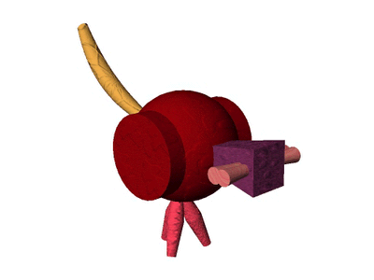

Slide 7
This is a wug:

Slide 9
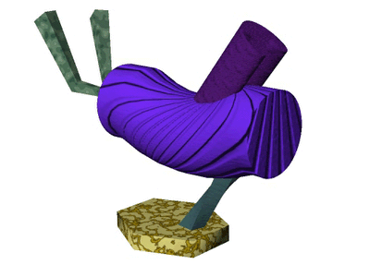

Slide 11
This is a bim:

Slide 13
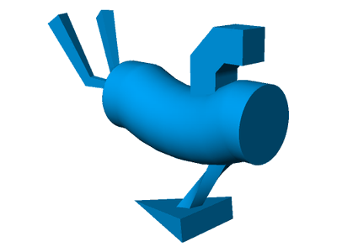

Slide 15
This is a dep:

Slide 17
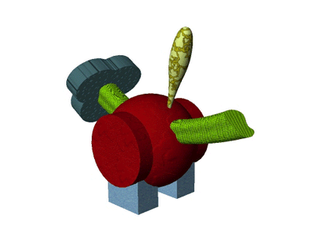

Slide 19
This is a wug:

Slide 21
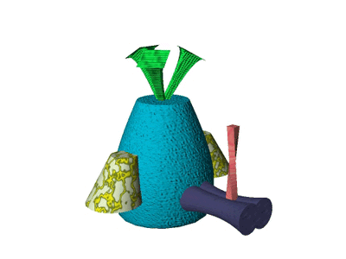

Slide 23
This is a dep:

Slide 25
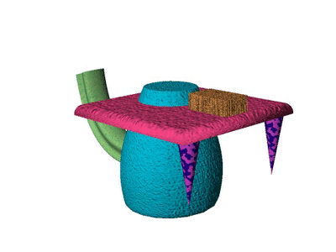

Slide 27
This is a wug:

Slide 29
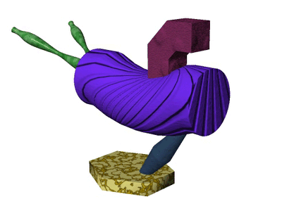

Slide 31
This is a bim:

Slide 33
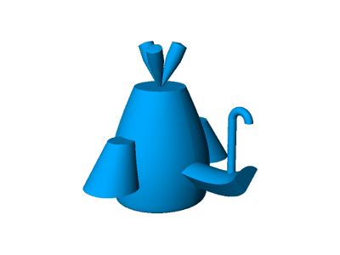

Slide 35
This is a wug:

Slide 37
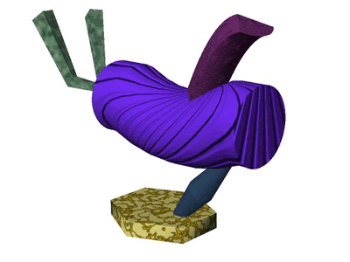

Slide 39
This is a dep:

Slide 41
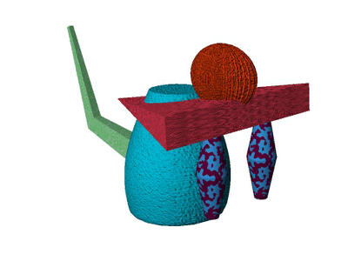

Slide 43
This is a tob:

Slide 45
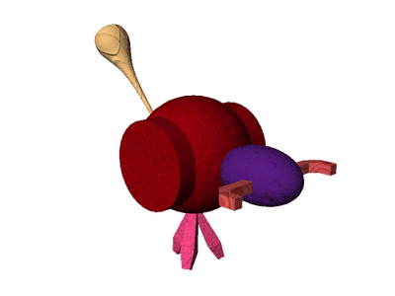

Slide 47
This is a dep:

Slide 49
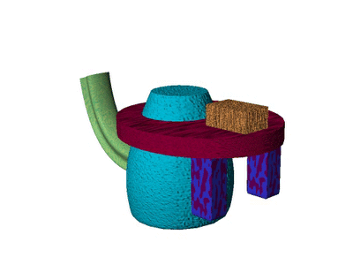

Slide 51
This is a bim:

Slide 53
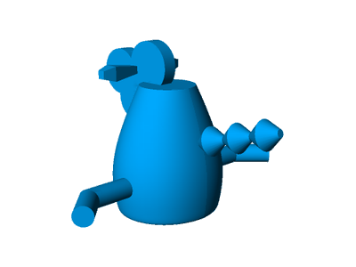

Slide 55
This is a wug:

Slide 57
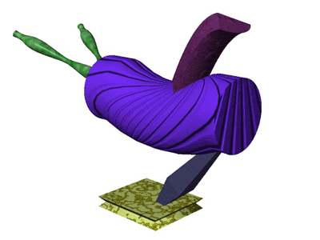

Slide 59
This is a tob:

Slide 61
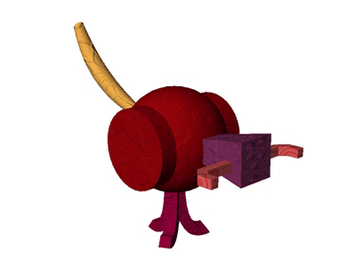

Slide 63
This is a dep:

Slide 65
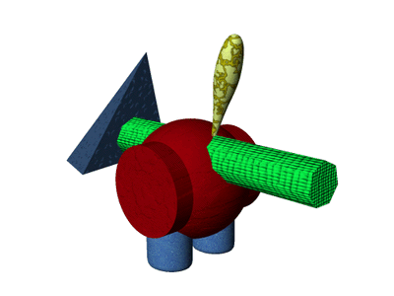

Slide 67
This is a bim:

Slide 69
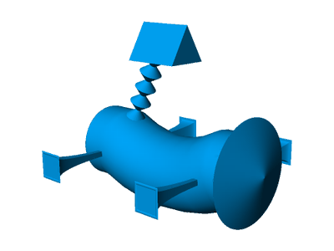

Slide 71
This is a tob:

Slide 73
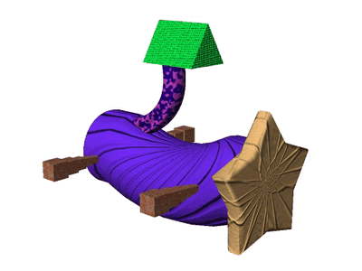

Slide 75
This is a wug:

Slide 77
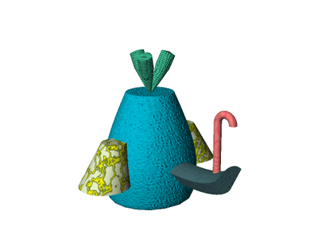

Slide 79
This is a bim:

Slide 81
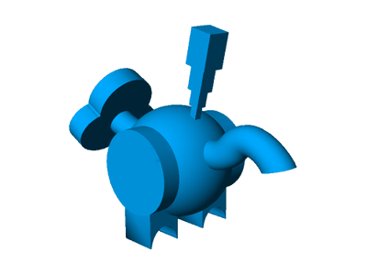

Slide 83
This is a dep:

Slide 85
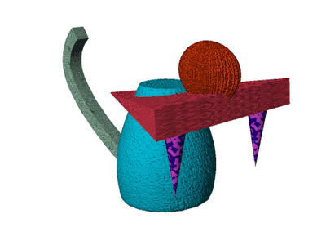

Slide 87
This is a bim:

Slide 89
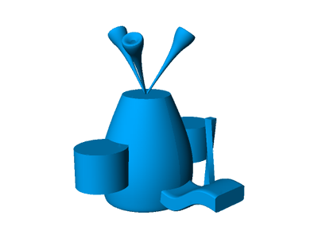

Slide 91
This is a tob:

Slide 93
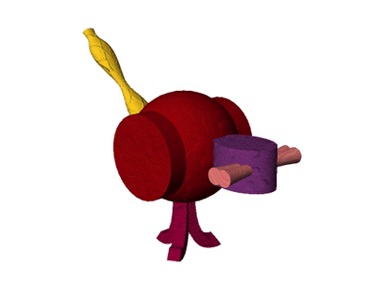

Slide 95
This is a wug:

Slide 97
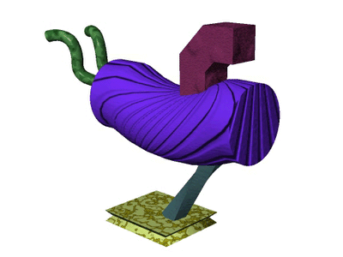

Slide 99
This is a dep:

Slide 101
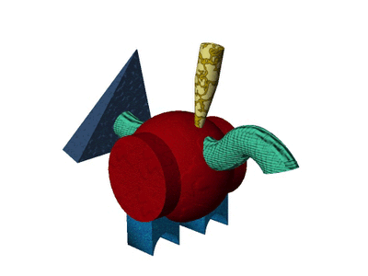

Slide 103
This is a wug:

Slide 105
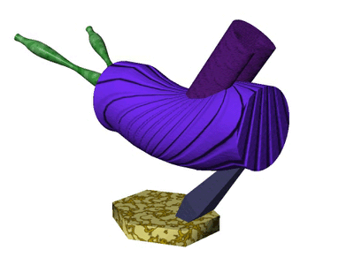

Slide 107
This is a bim:

Slide 109
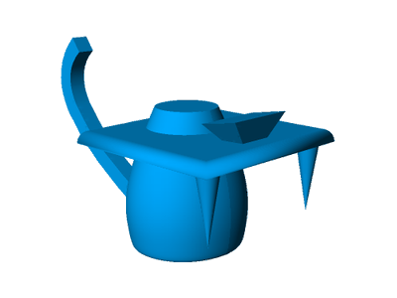

Slide 111
This is a dep:

Slide 113
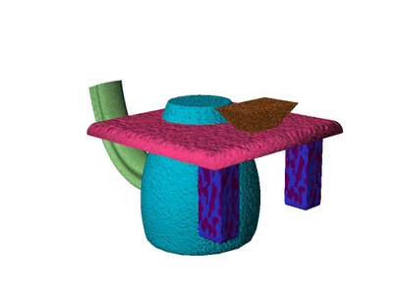

Slide 115
This is a tob:

Slide 117
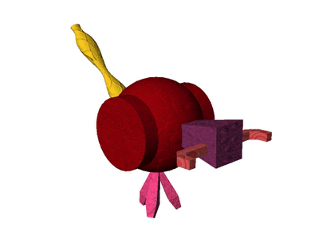

Slide 119
This is a dep:

Slide 121
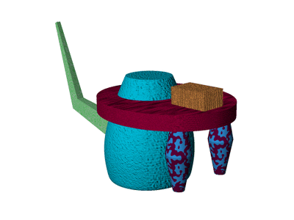

Slide 123
This is a wug:

Slide 125
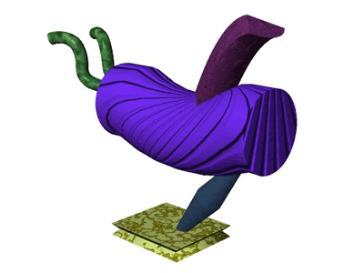

Slide 127
This is a tob:

Slide 129
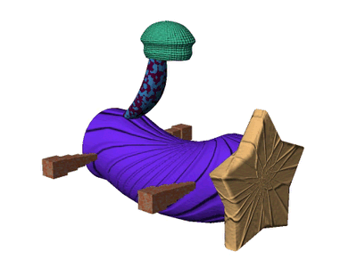

Slide 131
This is a bim:

Slide 133
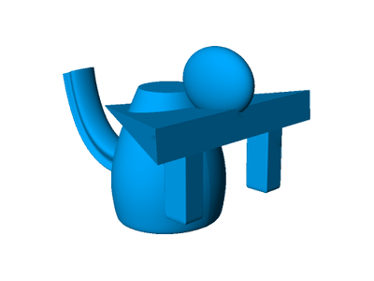

Slide 135
This is a tob:

Slide 137
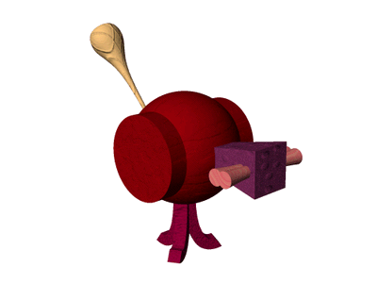

Slide 139
This is a bim:

Slide 141
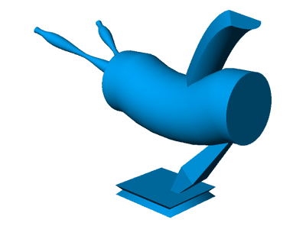

Slide 143
This is a dep:

Slide 145
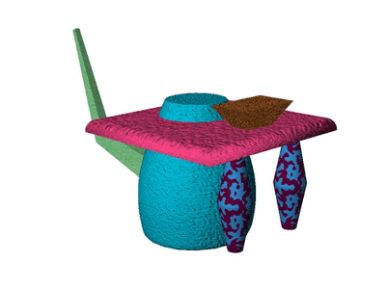

Slide 147
This is a tob:

Slide 149
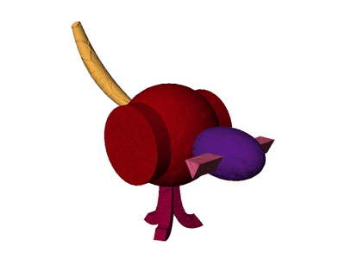

Slide 151
This is a wug:

Slide 153
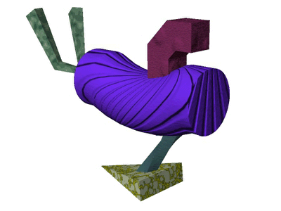

Slide 155
This is a bim:

Slide 157
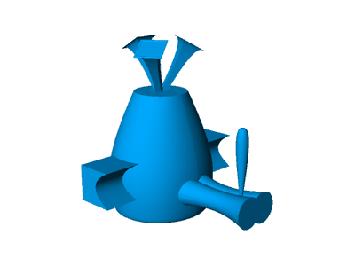

Slide 159
This is a tob:

Slide 161
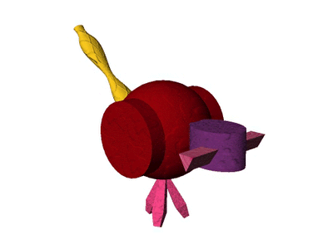

Slide 163
This is a bim:

Slide 165
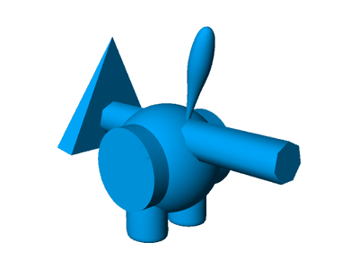

Slide 167
This is a dep:

Slide 169
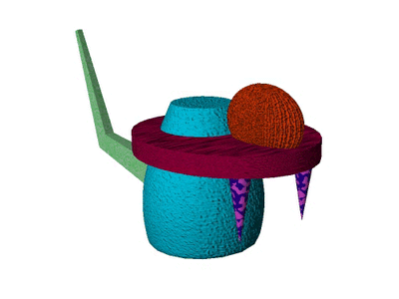

Slide 171
This is a wug:

Slide 173
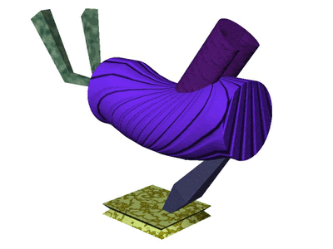

Slide 175
This is a bim:

Slide 177
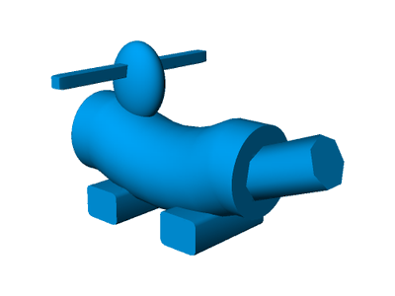

Slide 179
This is a wug:

Slide 181
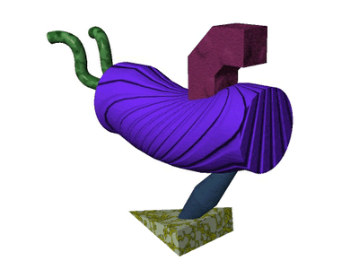

Slide 183
This is a dep:

Slide 185
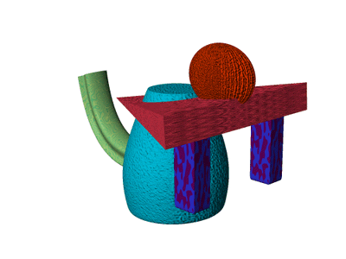

Slide 187
This is a tob:

Slide 189
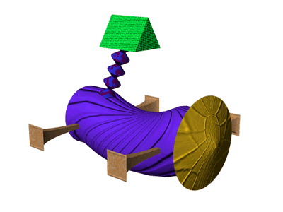

Slide 191
This is a bim:

Slide 193
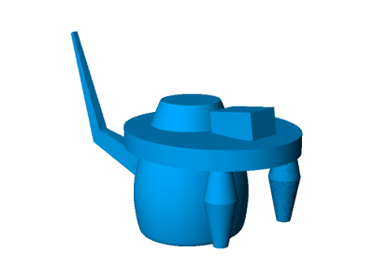

Slide 195
This is a dep:

Slide 197
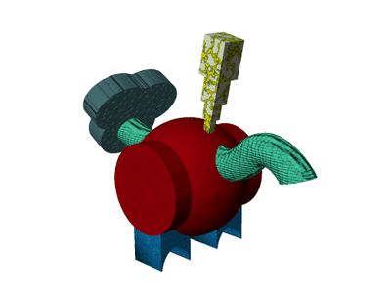

Slide 199
This is a tob:

Slide 201
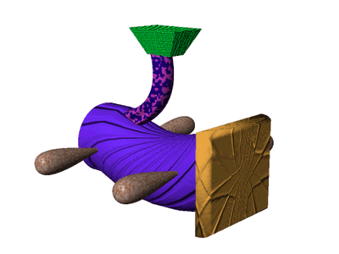

Slide 203
This is a bim:

Slide 205


Slide 207
This is a wug:

Slide 209


Slide 211
This is a tob:

Slide 213


Slide 215
This is a dep:

Slide 217


Slide 219
This is a bim:

Slide 221


Slide 223
This is a tob:

Slide 225


Slide 227
This is a dep:

Slide 229


Slide 231
This is a wug:

Slide 233


Slide 235
This is a dep:

Slide 237


Slide 239
This is a wug:

Slide 241


Slide 243
This is a bim:

Slide 245


Slide 247
This is a dep:

Slide 249


Slide 251
This is a bim:

Slide 253


Slide 255
This is a tob:

Slide 257


Slide 259
This is a wug:

Slide 261


Slide 263
This is a dep:

Slide 265


Slide 267
This is a tob:

Slide 269


Slide 271
This is a wug:

Slide 273


Slide 275
This is a tob:

Slide 277


Slide 279
This is a dep:

Slide 281


Slide 283
This is a wug:

Slide 285


Slide 287
This is a bim:

Slide 289


Slide 291
This is a wug:

Slide 293


Slide 295
This is a dep:

Slide 297


Slide 299
This is a tob:

Slide 301


Slide 303
This is a bim:

Slide 305


Slide 307
This is a tob:

Slide 309


Slide 311
This is a wug:

Slide 313


Slide 315
This is a bim:

Slide 317


Slide 319
This is a tob:

Slide 321


Slide 323
Time for a break!

Slide 324
Ready?

Slide 326
This is a wug:

Slide 330
This is a bim:

Slide 334
This is a wug:

Slide 338
This is a dep:

Slide 342
This is a bim:

Slide 346
This is a tob:

Slide 350
This is a wug:

Slide 354
This is a tob:

Slide 358
This is a bim:

Slide 362
This is a dep:

Slide 366
This is a wug:

Slide 370
This is a tob:

Slide 374
This is a bim:

Slide 378
This is a tob:

Slide 382
This is a wug:

Slide 386
This is a tob:

Slide 390
This is a dep:

Slide 394
This is a bim:

Slide 398
This is a dep:

Slide 402
This is a bim:

Slide 406
This is a tob:

Slide 410
This is a bim:

Slide 414
This is a dep:

Slide 418
This is a tob:

Slide 422
This is a dep:

Slide 426
This is a wug:

Slide 430
This is a bim:

Slide 434
This is a dep:

Slide 438
This is a wug:

Slide 442
This is a bim:

Slide 446
This is a tob:

Slide 450
This is a wug:

Slide 454
This is a tob:

Slide 458
This is a wug:

Slide 462
This is a bim:

Slide 466
This is a dep:

Slide 470
This is a tob:

Slide 474
This is a dep:

Slide 478
This is a wug:

Slide 482
This is a dep:

Slide 486
This is a bim:

Slide 490
This is a wug:

Slide 494
This is a bim:

Slide 498
This is a tob:

Slide 502
This is a bim:

Slide 506
This is a tob:

Slide 510
This is a dep:

Slide 514
This is a wug:

Slide 518
This is a tob:

Slide 522
This is a wug:

Slide 526
This is a bim:

Slide 530
This is a dep:

Slide 534
This is a tob:

Slide 538
This is a dep:

Slide 542
This is a tob:

Slide 546
This is a wug:

Slide 550
This is a tob:

Slide 554
This is a bim:

Slide 558
This is a wug:

Slide 562
This is a dep:

Slide 566
This is a tob:

Slide 570
This is a wug:

Slide 574
This is a bim:

Slide 578
This is a dep:

Slide 582
This is a bim:

Slide 586
This is a tob:

Slide 590
This is a wug:

Slide 594
This is a bim:

Slide 598
This is a dep:

Slide 602
This is a wug:

Slide 606
This is a dep:

Slide 610
This is a wug:

Slide 614
This is a bim:

Slide 618
This is a tob:

Slide 622
This is a dep:

Slide 626
This is a bim:

Slide 630
This is a dep:

Slide 634
This is a tob:

Slide 638
This is a dep:

Slide 642
This is a wug:

Slide 646
End of training. Please get the experimenter.

